Slide 1
The Many Different Styles of Chinese Architecture
Kyle Robinson Chin101

Slide 2
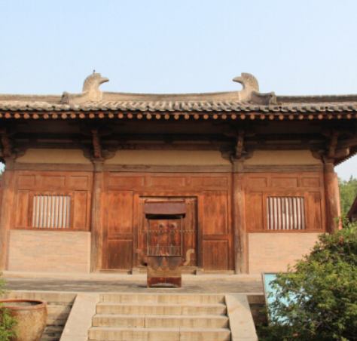
An Overview of Chinese Architecture
An ancient style:
Chinese architecture has developed over a millennia
  General structures remain largely unchanged
  Ancient buildings were built of timber
    Don’t survive today
Nanchan temple

Slide 3
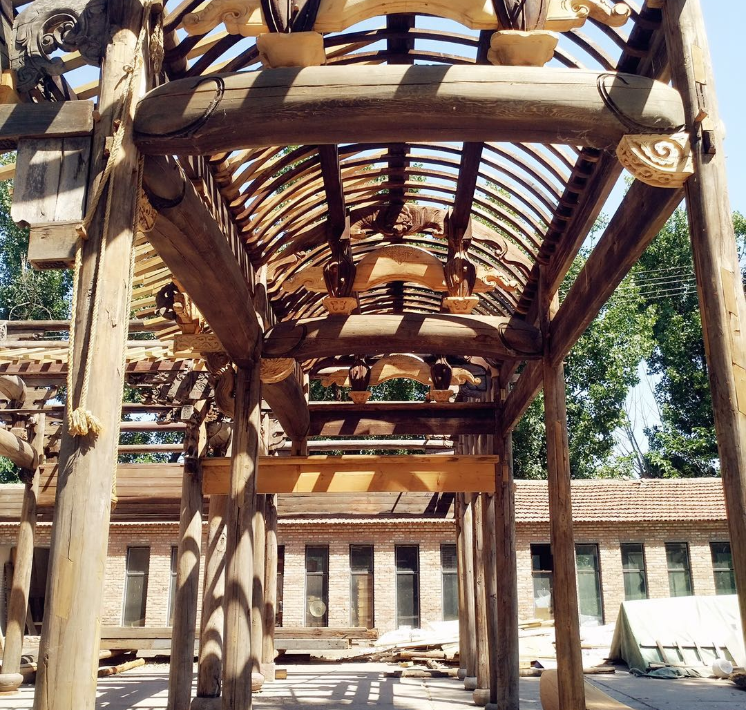
Wooden Architecture
Traditional lumber architecture
Wood was abundant
  Easy to build with, easy to decorate
Features
  Built atop stamped earth base
  Wooden pillars bear weight
  Flexible brackets hold up roof
Wood was considered lucky
  Spring and life

Slide 4
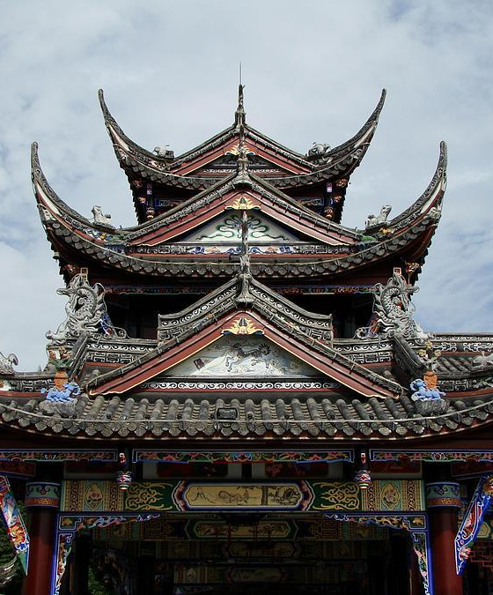
Practicality in Design
Style developing from practicality
A style that fit a growing population
  Wood structures could be built quickly and easily expanded upon
    Suitable for rapid population growth
Wood is susceptible to elements
  Sloping, tiled roofs protect wood from wind and rain

Slide 5
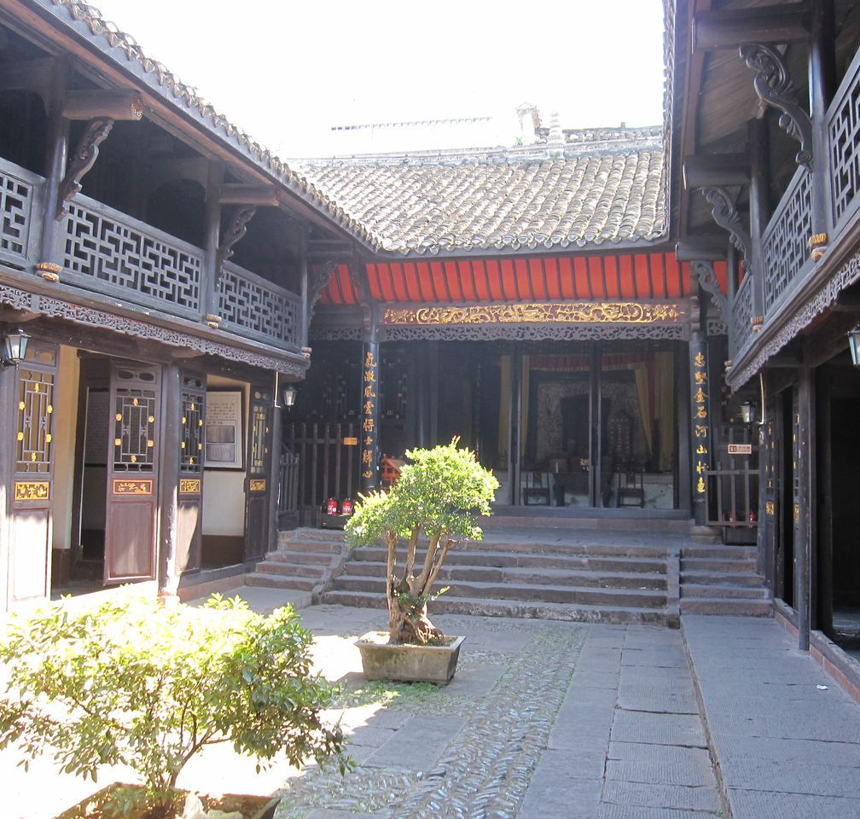
Practicality in Design Continued
Style developing from practicality
Natural disasters
  Wooden structures withstand earthquakes
  Easy to rebuild
Seasons
  Structures built with shortest buildings facing south
    Allows for sun-warming during the winter

Slide 6
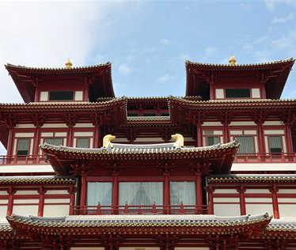
Decorative Choices
Not just practicality
Bilateral symmetry
  Symmetry represents equilibrium
Gardens
  Gardens harmonized human and nature
    Meant to be mini landscapes
Colors
  Red (luck), blue (heaven), green (wealth), and yellow (royalty)

Slide 7
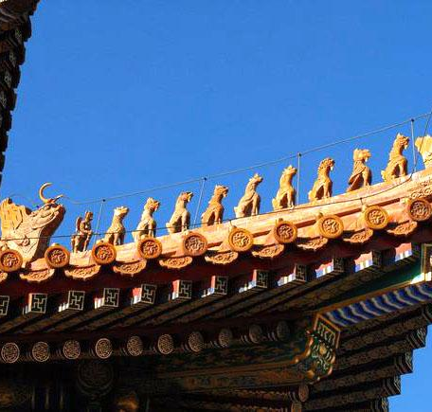
Ridge Beasts
Elements of decoration and belief
Rows of decorative beasts from mythology
  Believed to protect buildings from harm
  Dragons and phoenixes
    Protect buildings from fire and bring good luck
Amount of decorative beasts changes with status

Slide 8
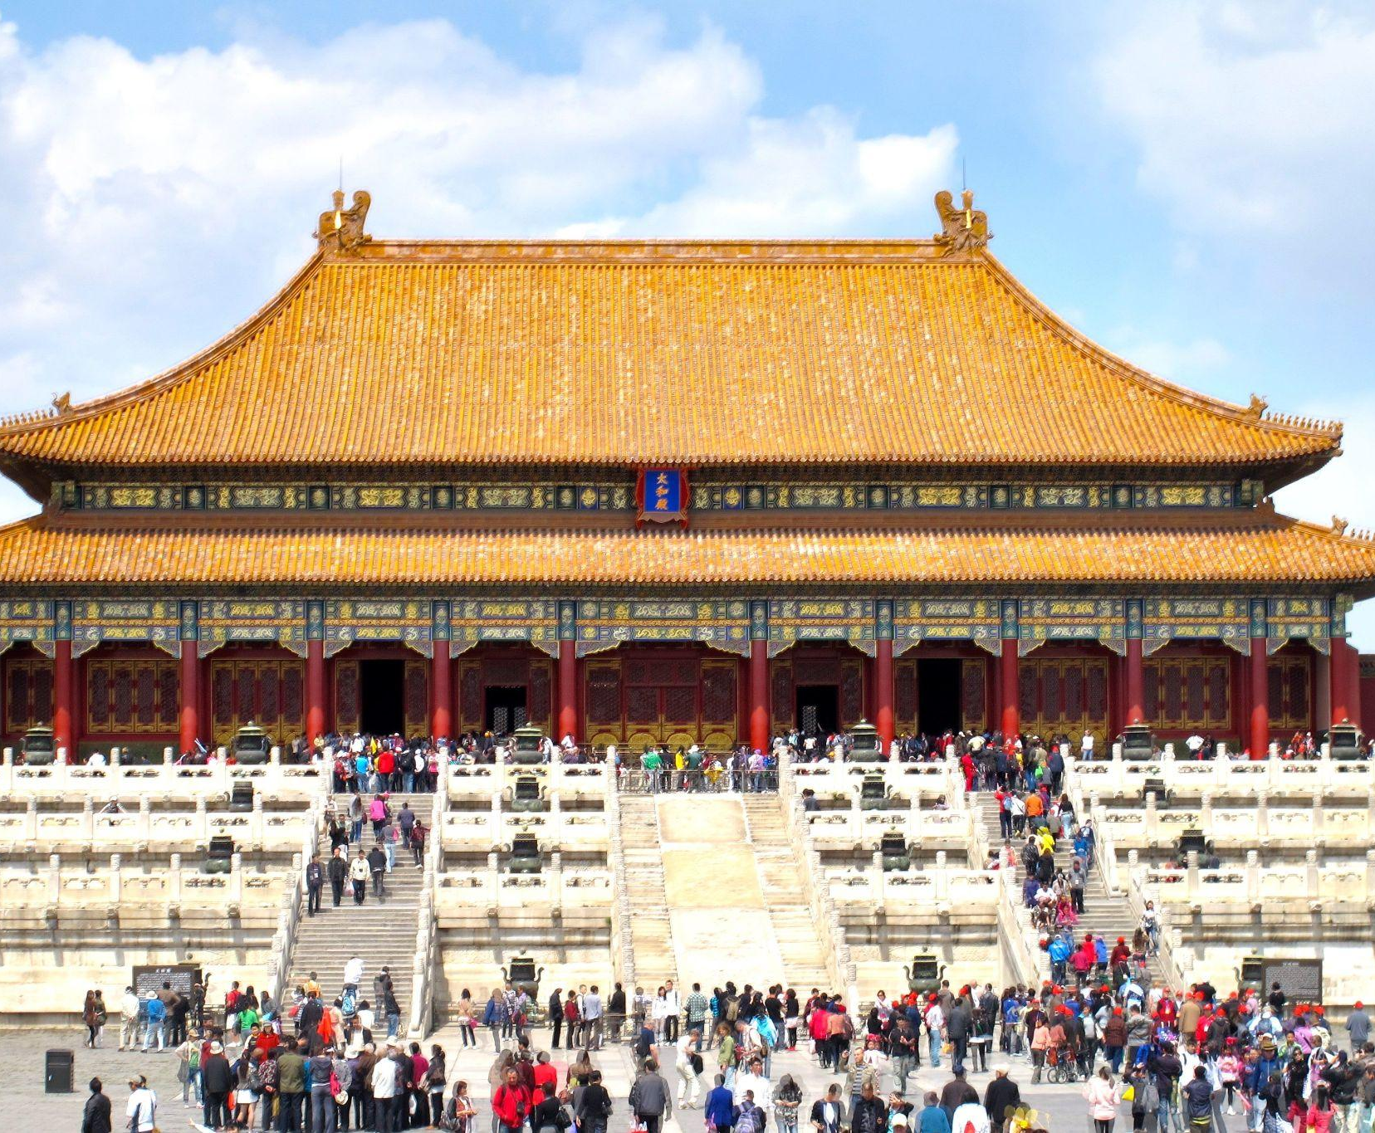
Imperial Architecture Distinctions
A different style
Exclusive decorative elements
  Yellow tiled roofs reserved
  Special hip roofs
Gates
  Forbidden city had 3 gates
    Only important citizens could enter largest one
  Hierarchical culture

Slide 9
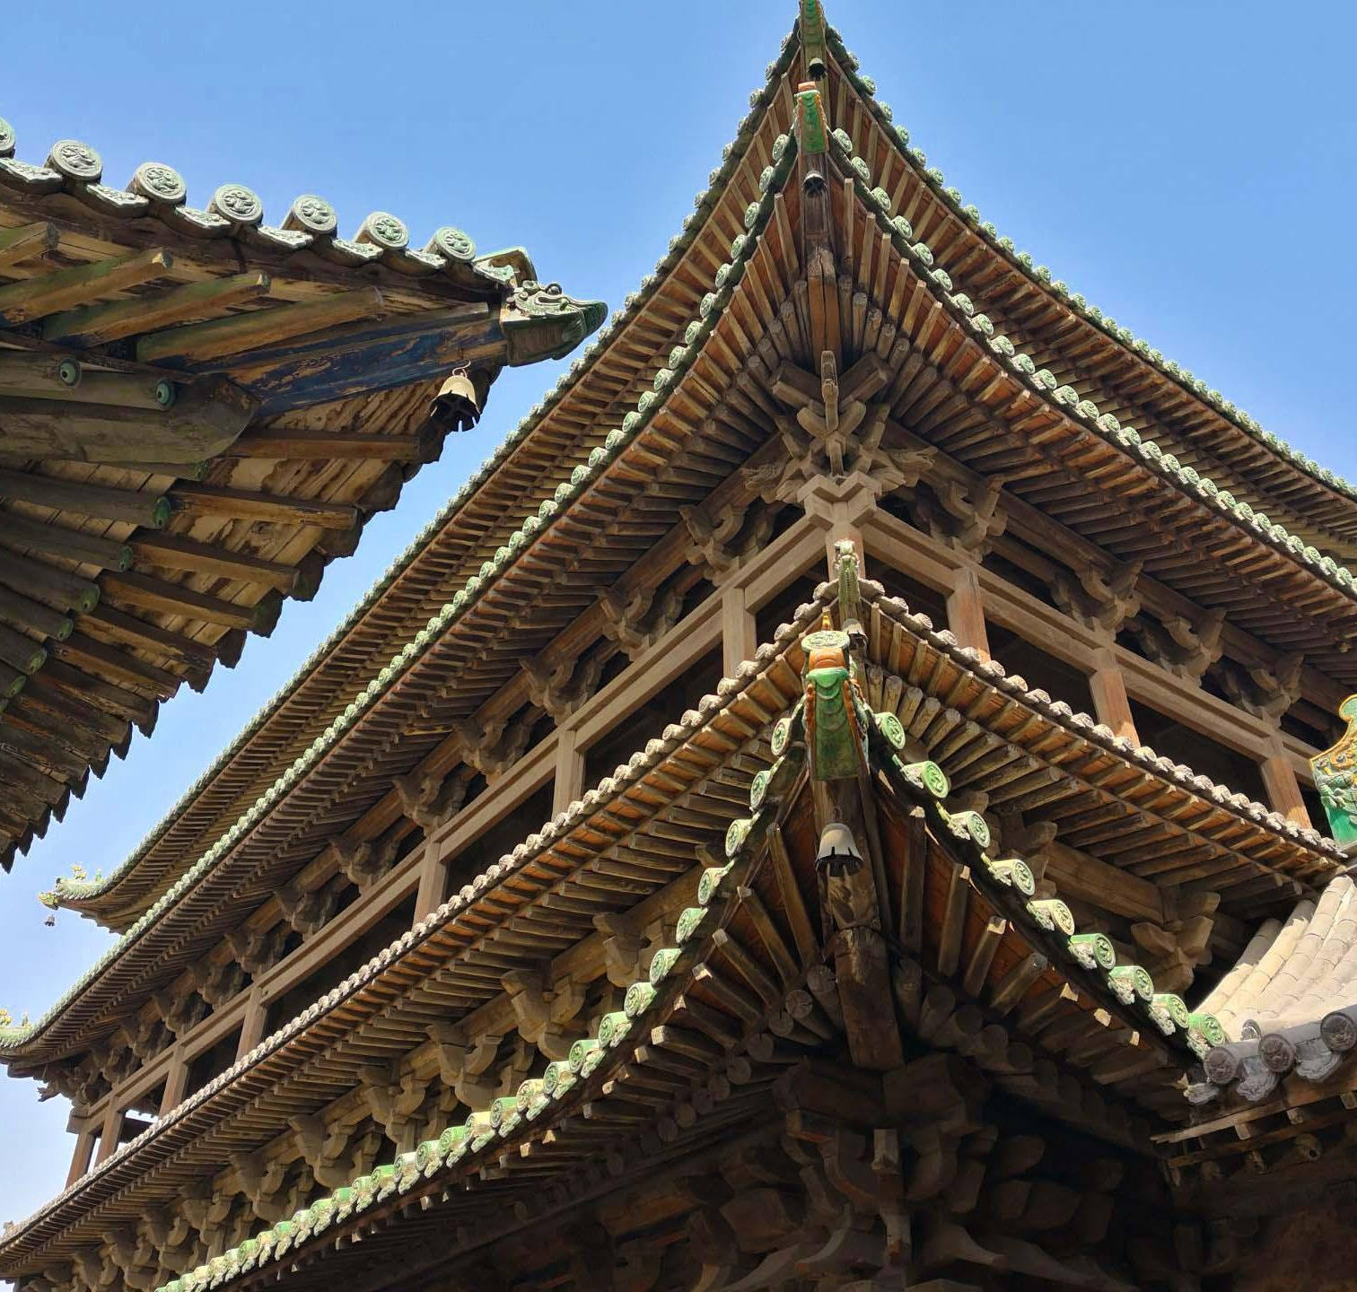
Architecture as Hierarchy
Roofs denoting status
Different roof styles used for different classes of building
  Hip: only for emperors, fanciest
  Resting hill: used for official buildings
  Hanging hill: richer citizens
  Hard hill: low class/commoners
Number of slopes and level of decoration increase with status

Slide 10
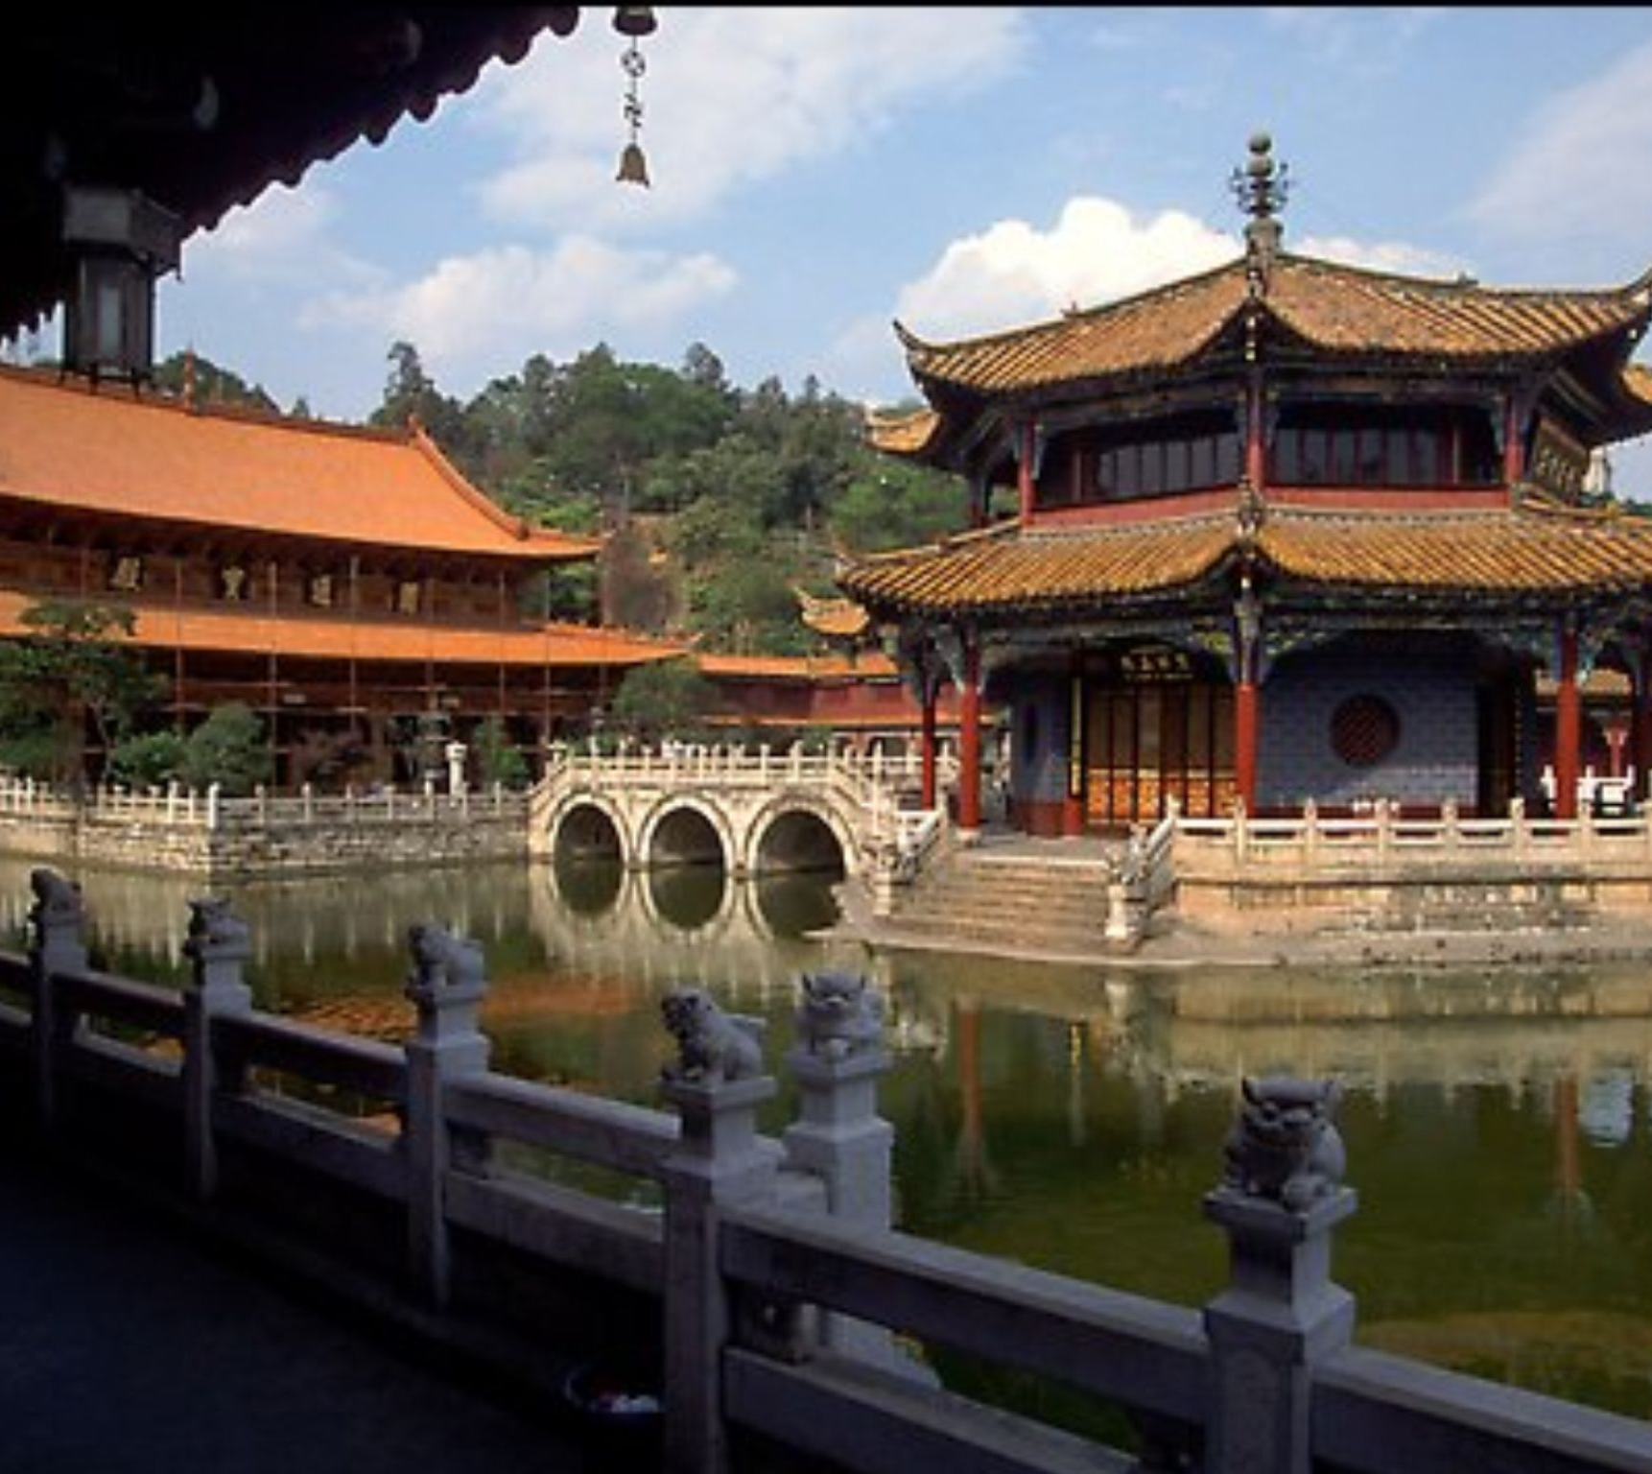
Buddhist Religious Architecture
Buddhist pagodas
Structure
  Build around central column
Largely similar to imperial designs
  Often China’s tallest buildings historically
Changes throughout time
  Early designs 4 sided, later 8 sided
  Stone used, though wood allowed for more height

Slide 11

Overall: A Broader Look
Common elements, different uses
Colors
  Color very important, exclusively used
Decoration
  Increased with status
Roofs
  Also developed with status
Materials
  Vastly remained the same

Slide 12
Works Cited
Pang, Kelly. “Chinese Architecture.” Chinese Architecture: Features, Culture, Types, Decor, China Highlights, 17 Jan. 2024, www.chinahighlights.com/travelguide/architecture/.
Silbergeld, Jerome. “Chinese Architecture.” Encyclopædia Britannica, Encyclopædia Britannica, inc., www.britannica.com/art/Chinese-architecture. Accessed 18 Mar. 2024.
van Huyssteen, Justin. “Chinese Architecture - History and Hallmarks of an Enduring Style.” Art in Context, Faessler Media Ltd, 22 Aug. 2023, artincontext.org/chinese-architecture/.
Pang, Kelly. “Chinese Wooden Architecture: Why Wood Was Used and How.” Chinese Wooden Architecture: Why Wood Was Used and How, Chinese Highlights, 17 Jan. 2024, www.chinahighlights.com/travelguide/architecture/why-most-traditional-chinese-architecture-was-wooden.htm.
Pang, Kelly. “The 7 Most Prominent Features of Ancient Chinese Architecture.” Features of Ancient Chinese Architecture, Chinese Architecture’s Features, China Highlights, 17 Jan. 2024, www.chinahighlights.com/travelguide/architecture/features.htm.

Slide 13
Works Cited
“Traditional Elements in Chinese Architecture.” Traditional Elements in Chinese Architecture | ArchitectureCourses.Org, Architecturecourses.org, architecturecourses.org/learn/traditional-elements-chinese-architecture. Accessed 18 Mar. 2024.
Pang, Kelly. “Traditional Chinese Roofs - China’s Roof Architecture.” Traditional Chinese Roofs, China’s Roof Architecture, China Highlights, 17 Jan. 2024, www.chinahighlights.com/travelguide/architecture/roofs.htm.
Cartwright, Mark. “Ancient Chinese Architecture.” World History Encyclopedia, World History Publishing, 24 Oct. 2017, www.worldhistory.org/Chinese_Architecture/.

